Slide 1
Chapter 12 The Bond Market

Slide 2
Financial System Overview (2)
Financial Markets
Financial Institutions
Bond Market (3,5,12)
Stock Market (13,6)
Money Market (11)
Mortgage Market (14)
Why Exists (7)
Banking Industry (19)
Mutual Fund Industry(20)
Hedging with Financial Derivatives (24)

Slide 3
Chapter Outline
Overview of bond markets
Characteristics and trading process of different bond market securities
Treasury bond market
Municipal bond market
Corporate bond market
Major bond market participants
International bond markets

Slide 4
Overview of the Bond Markets
What’s bond?
Long-term debt obligations
Issued by corporations and government units
bond issuers promise to make periodic coupon payments and to repay principal at maturity;
breech of this promise is an event of default, the bond holder has a claim on the assets of the bond issuer.
Bonds carry original maturities greater than one year so bonds are instruments of the capital markets. (how about equity?)

Slide 5
Overview of the Bond Markets
What’s bond markets?
markets in which bonds are issued and traded.
Assist to transfer funds from units with excess funds to unites in need of long-term debt funding
Three major bond markets
Treasury notes and bonds
Municipal bonds
Corporate bonds

Slide 6
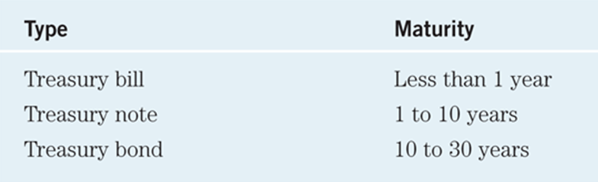
Treasury Notes and Bonds
The U.S. Treasury issues notes and bonds to finance its operations.
The following table summarizes the maturity differences among the various Treasury securities.

Slide 7
Treasury Bond Interest Rates
No default risk since the Treasury can print money to payoff the debt
Pay coupon interest (semiannually)
Very low interest rates, often considered risk-free rate
Given their longer maturity, not entirely risk free:
Interest rate risk due to interest rate fluctuations
Liquidity risk (off-the-run issues is less liquid than on-the-run issues)

Slide 8
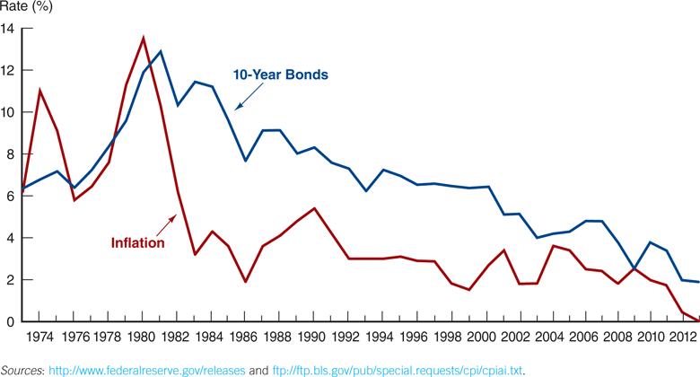
Treasury Bond Interest Rates
Figure 12.2 Interest Rate on Treasury Bonds and the Inflation Rate, 1973–2013 (January of each year)

Slide 9
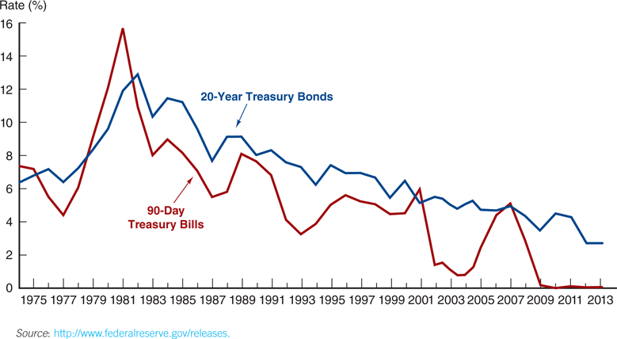
Treasury Bond Interest Rates: Bills vs. Bonds
Figure 12.3 Interest Rate on Treasury Bills and Treasury Bonds, 1974–2013 (January of each year)

Slide 10
Treasury Bonds: Recent Innovation
Treasury Inflation-Indexed Securities (TIPS): the principal amount is tied to the current rate of inflation to protect investor purchasing power
Treasury STRIPS: the coupon and principal payments are “stripped” from a T-Bond and sold as individual zero-coupon bonds.
STRIPS: Separate Trading of Registered Interest and Principal Securities

Slide 11
Treasury Bonds: Recent Innovation (TIPS)
The Treasury issues two types of notes and bonds:
Fixed principal
Inflation-indexed (the semiannual coupon payments and the final principal payment are based on the inflation-adjusted principal value
Example for fixed principal and inflation-indexed
A 2-year, 10% coupon bond issued with a principal of $1,000, assume 10% inflation for each year.
For fixed principal: coupon payment will be $100, $100 for the first and second year. At maturity day, will pay $1,000
For inflation-indexed:
First year: principal value: $1,000*1.1=$1,100, so coupon payment will be: $1,100*10%=$110
Second year: principal value: $1,000*(1.1)²=$1,210, so coupon payment will be: $1,210*10%=$121
At the maturity day, principal payment will be $1,210

Slide 12
Treasury Bonds: Recent Innovation (STRIPS)
STRIP:
Separate Trading of Registered Interest and Principal Securities
A treasury security in which the individual interest payments are separated from the principal payment
Effectively creates two sets of securities:
One for each semiannual interest payment
One for the final principal payment
Both are often referred to as “Treasury zero-coupon bonds”
Created by U.S. Treasury in response to separate trading of treasury security principal and interest developed by securities firms
U.S. Treasury does not issue STRIPs directly to investors. Only available through Financial Institutions and government securities brokers and dealers
Attractive to investors desiring particular maturity zero-coupon bonds to meet investment goals and needs.

Slide 13
Examples for Treasury STRIPS
Example 1:
Suppose the Treasury issues a five-year T-note, par value $10,000, and 8% coupon rate, paid semiannually. To Citigroup.
Citigroup can convert the bond into 11 securities
10 securities associated with each semiannual coupon payment
1 securities associated with the par value. $10,000
Example 2: Using Strip to immunize against Interest Rate Risk
Suppose that it is 2007 and an insurer must make a guaranteed payment to an investor in five years, 2012. Assume, this target guaranteed payment is $1,469,000, a lump sum policy payout on retirement, equivalent to investing $1,000,000 at an annually compounded rate of 8% over five years.
How to guarantee the insurance company would produce a $1,469,000 cash flow in five years, no matter what happens to interest rates in the future?

Slide 14
Primary Market of Treasury Notes and Bonds
Treasury sells T-notes and bonds through competitive and noncompetitive auctions (https://www.treasurydirect.gov/instit/annceresult/annceresult.htm)
On the day of auction, bids may be submitted until noon for noncompetitive bids and 1 p.m. for competitive bids
Results are announced the following day.
The auction is uniform auction after 1998, before that, Treasury used discriminatory auction.
Auction Pattern for Treasury Notes and bonds
Security Purchase Minimum General Auction Schedule
2-year note $1,000 Monthly
3-year note $1,000 Feb, May, Aug, Nov
5-year note $1,000 Feb, May, Aug, Nov
10-year note $1,000 Feb, May, Aug, Nov
30-year note $1,000 Feb, Aug

Slide 15
Secondary Market of Treasury Notes and Bonds
Most secondary market trading occurs directly through brokers and dealers
Wall Street Journal shows full list of Treasury securities that trade daily

Slide 16
Treasury Bonds: Agency Debt
Although not technically Treasury securities, agency bonds are issued by government-sponsored entities, such as Government National Mortgage Association (GNMA, or Ginnie Mae), Federal National Mortgage Association (FNMA, or Fannie Mae) and Federal Home Loan Mortgage Corporation (FHLMC, or Freddie Mac).
Usually secured by the loans that are made with the funds raised by the bond sales.
The debt has an “implicit” guarantee that the U.S. government will not let the debt default.
This “guarantee” was clear during the 2008 bailout…

Slide 17
The 2007–2009 Financial Crisis: Bailout of Fannie and Freddie
https://www.youtube.com/watch?v=SGYVb3mpkY4
Both Fannie and Freddie managed their political situation effectively, allowing them to engage in risky activities, despite concerns raised.
Moral hazard problems + weak regulation
By 2008, the two had purchased or guaranteed over $5 trillion in mortgages or mortgage-backed securities.
Part of this growth was driven by their Congressional mission to support affordable housing. They did this by purchasing subprime and Alt-A mortgages.
As these mortgages defaults, large losses mounted for both agencies.

Slide 18
The 2007–2009 Financial Crisis: Bailout of Fannie and Freddie
In 2013, Fannie Mae repaid $59.4 billion of its $117 billion in bailout.
Freddie Mac has paid back about $37 billion of the $72 billion it received.
With the housing market recovery, Fannie Mae and Freddy Mac have been able to pay dividends back to the government on its $187 billion investment.
By October of 2016, the two agencies had paid $250 billion in dividends to the treasury.

Slide 19
Municipal Bonds
Issued by local, county, and state governments
Used to finance public interest projects
Tax-free municipal interest rate
Two types
General obligation bonds
Revenue bonds
NOT default-free (e.g., Orange County California)
Defaults in 1990 amounted to $1.4 billion in this market

Slide 20
Municipal Bonds: Example
Suppose the rate on a corporate bond is 9% and the rate on a municipal bond is 6.75%. Which should you choose?
Answer: Find the marginal tax rate:
6.75% = 9% × (1 – MTR), or MTR = 25%
If you are in a marginal tax rate above 25%, the municipal bond offers a higher after-tax cash flow.

Slide 21
Municipal Bonds: Example
Suppose the rate on a corporate bond is 5% and the rate on a municipal bond is 3.8%. Which should you choose? Your marginal tax rate is 28%.
Find the equivalent tax-free rate (ETFR):
ETFR = 5% × (1 – MTR) = 5% × (1 – 0.28)
The ETFR = 3.60%. If the actual muni-rate is above this (it is), choose the muni.

Slide 22
Two Types of Municipal Bonds
General obligation bonds
Do not have specific assets pledged as security or a specific source of revenue allocated for their repayment.
They are backed by the “full faith and credit” of the issuer.
Represent a small portion of municipal bonds(38%)
New GO generally requires local taxpayer approval
Taxpayer reluctance to have their taxes increased
Revenue bonds
bonds sold to finance a specific revenue generating project and are backed by cash flows from that project. E.g., Revenue bonds may be issued to build a toll road, high school, hospital, and etc.
Cannot use general tax revenue to pay
Conclusion
Municipal bonds are not default free
Revenue Bonds are generally riskier than GO Bonds
Default case: 1983 Washington Public Power Supply System, to finance the construction of two nuclear power plants.

Slide 23
Primary Market Placement Choices for Muni.
General Public Offering
underwriter is selected either by negotiation or by competitive bidding
the underwriter offers the bonds to the general public
Privately placed securities (Rule 144A Placement)
bonds are sold on a semi-private basis to qualified investors (generally FIs)
Privately placed bonds are among the most illiquid securities in the bond market
Only very largest FIs being able or willing to buy and hold
Absent of an active secondary market

Slide 24
Contracting Choices with the Underwriter
Firm commitment agreement:
Investment Banks buy all the bonds from the issuer first at lower price, and then try to resell them to investors at a higher price
Investment Banks earn the spread
Issuer have no risk and can get the proceeds immediately
Best efforts agreement:
Investment banker charges a fee to help sell the securities to public
The issuer takes the risk of any securities that cannot be sold.
Unsold securities are returned to the issuer.
Total Fees: Up to 10% for equity, 1.3% for debt
Investment Banks tend to underprice IPOs

Slide 25
Example for Firm commitment agreement
Issuer wants to sell 10M shares at $1,000 each to raise $10B
Uncertainty: Will the market buy? How long before all the shares are sold?
The issuer does not want to take this risk
The investment banker will assume the risk for a price
The price (spread) depends on the market conditions, the issuer’s reputation, the type of security, etc.
Investment banker buys all the shares at $990 per share.
The issuer gets the money immediately.
The investment bank takes the risk of finding the buyers
The average sale price: $1,005.
The investment banker’s profit: $15 per share or $150 million.

Slide 26
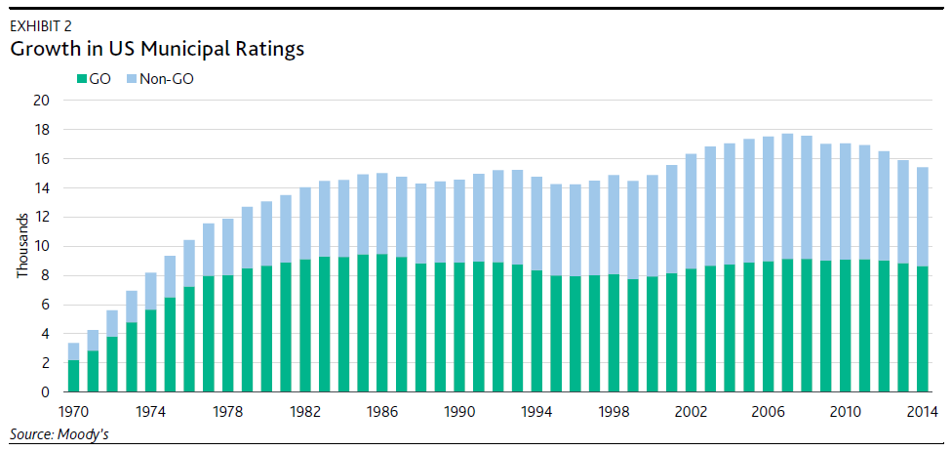
Figure Issuance of Revenue and General Obligation Bonds, 1970–2014

Slide 27
Secondary Market for Muni.
Secondary market is thin (i.e. trades are relatively infrequent):
Lack of information on bond issuers, who are generally much smaller than corporate bond issuers
Information on municipal bond issuers is generally more costly to obtain and evaluate

Slide 28
Corporate Bonds
Typically have a face value of $1,000, although some have a face value of $5,000 or $10,000
Generally pay interest semi-annually
Cannot be redeemed anytime the issuer wishes, unless a specific clause states this (call option).
Degree of risk varies with each bond, even from the same issuer. Following suite, the required interest rate varies with level of risk.
The degree of risk ranges from low-risk (AAA) to higher risk (BBB). Any bonds rated below BBB are considered sub-investment grade debt.

Slide 29
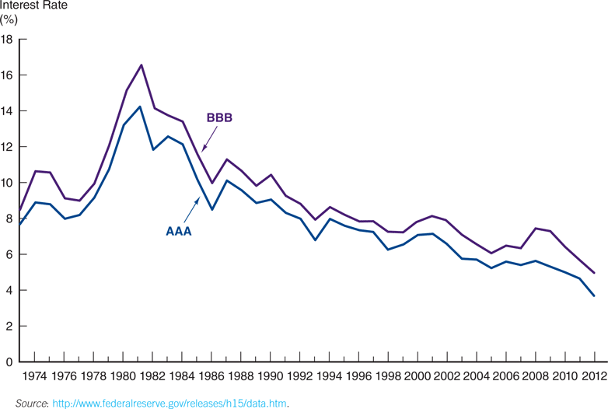
Corporate Bonds: Interest Rates
Figure 12.5 Corporate Bond Interest Rates, 1973–2012 (End of year)

Slide 30
Types of Corporate Bonds
Bearer bonds Vs. Registered bonds
Bearer bonds: coupons are attached to the bond and the holder (bearer) at the time of the coupon payment gets the relevant coupon paid on presentation to the issuer.
Registered bonds: the bond holder’s (owner’s) identification information is kept in an electronic record by the issuer and the coupon payments are mailed or wire-transferred to the bank account of the registered owner.
Because of the lack of security with bearer bonds, they have largely replaced by registered bonds.
Term bonds Vs. Serial bonds
Term bonds: the entire issue matures on a single date
Serial bonds: the issue contains many maturity dates, with a portion of the issue being paid off on each date.
Most corporate bonds are term bonds.

Slide 31
Types of Corporate Bonds
Mortgage bonds
Finance specific projects that are pledged as collateral
Mortgage bond issues are secured debt issues
Bond holders may legally take title to the collateral to obtain payment on the bonds if issuer of mortgage bond defaults
Mortgage bonds are less risky investments than unsecured bonds → lower yields
Debentures Vs. Subordinated Debentures
Debentures: bonds backed solely by the general creditworthiness of the issuing firm, unsecured by specific assets or collateral
Subordinate Debentures: unsecured, junior in their rights to mortgage bonds and regular debentures.
Subordinated bonds are the riskiest type of bonds (high-yield or junk bonds)

Slide 32
Types of Corporate Bonds
Convertible bonds
Bonds that may be exchanged for another security of the issuing firm (e.g., common stock)
Conversion is an attractive option or feature to bond holders
So, the yield on a convertible bond is usually lower (generally, 2% to 5%) than that on a nonconvertible bond.
Cathay Pacific raises $870 mln in convertible bonds to shore up liquidity, shares plunge
Stock Warrant
Give the bond holder an opportunity to purchase common stock at a pre-specified price up to a pre-specified date
Bond holders will exercise their warrants if the market value of the stock is greater than the price at which the stock can be purchased through the warrant.
Risk firms commonly attach stock warrants to increase the bonds’ marketability.

Slide 33
Types of Corporate Bonds
Callable bonds
Call provision, which allows the issuer to require the bond holder to sell the bond back to the issuer at a given (call) price—usually set above the par value of the bond.
Call premium: difference between call price and face value
The closer the bond is to maturity, the smaller the premium
Bonds are usually called if interest rates drop
Higher required yield
Sinking Fund bonds
Sinking fund provision, which require the issuer retire a certain amount of bond issue early over a number of years.
A pool of money set aside by a corporation to help repay previous issues and keep it more financially stable as it sells bonds to investors.
It reduces the probability of default at the maturity date, this provision is an attractive feature to bond holders.
Bonds with a sinking fund provision are less risky, and generally have lower yields than comparable bonds without a sinking fund provision

Slide 34
Characteristics of Corporate Bonds
Restrictive Covenants
Agreement in an obligation that restricts the buyer from taking some action
Mitigates conflicts with shareholder interests
May limit dividends, new debt, ratios, etc.
Cannot merge
Cannot sale major assets
Limited dividend payments
Maintain working capital at a certain level

Slide 35
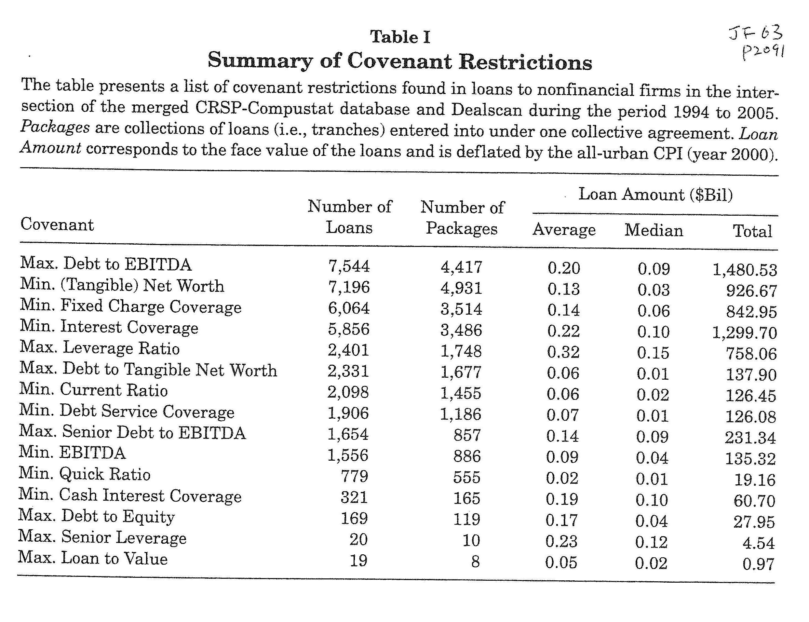

Slide 36
Primary and Secondary Markets for Corp Bonds
Primary sales of corp bonds occur through either a public sale (issue) or a private placement similar to municipal bonds
Two secondary markets
the exchange market (e.g., the NYSE)
the over-the-counter (OTC) market
OTC electronic market dominates trading in Corp bonds
Secondary market trading of corporate bonds can involve a significant degree of liquidity risk.

Slide 37
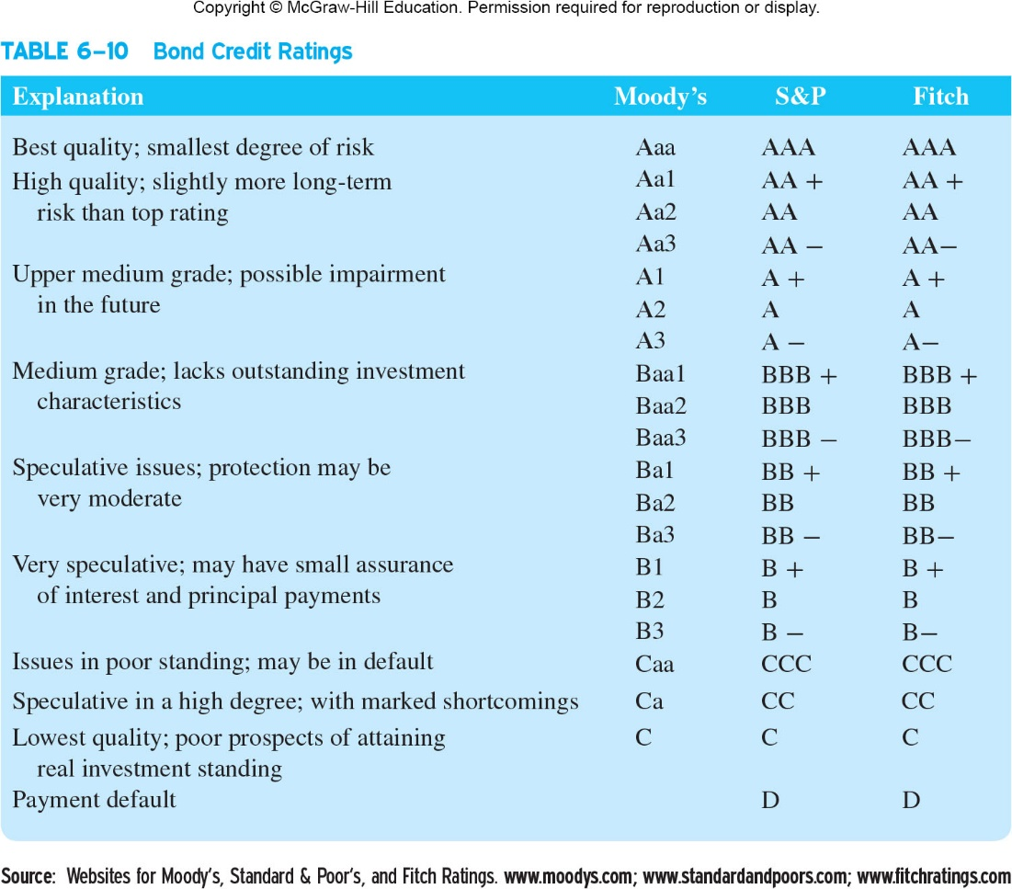

Slide 38
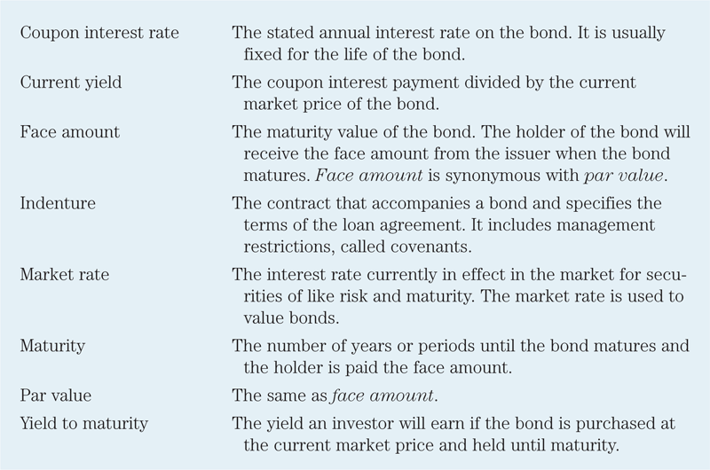
Table 12.3 Bond Terminology

Slide 39
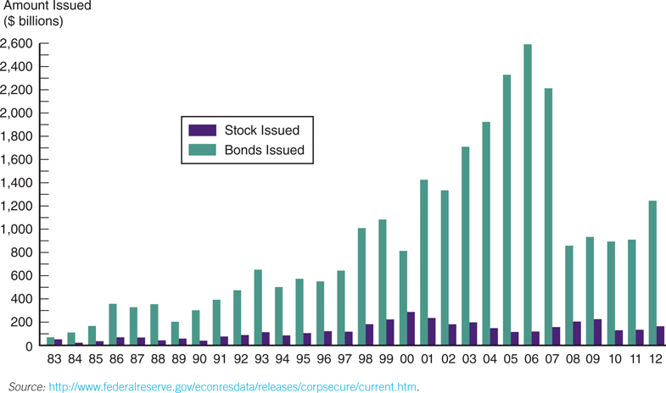
Figure 12.6 Bonds and Stocks Issued, 1983–2012

Slide 40
Bond Market Participants
The major issuers of debt market securities are federal, state and local governments and corporations
The major purchasers of capital market securities are households, businesses, government units and foreign investors
Businesses and financial firms (e.g., banks, insurance companies, mutual funds) are the major suppliers of funds for all three types of bonds.
Much of the business and financial holdings of bond securities reflects indirect investments of households.

Slide 41
International Aspects of Bond Markets
International bond market
trades bonds that are underwritten by an international syndicate
offer bonds simultaneously to investors in several countries
issue bonds outside the jurisdiction of any single country
offer bonds in unregistered form
Much of the growth has been driven by investors’ demand for international securities and international portfolio diversification

Slide 42
Eurobonds, Foreign Bonds, Brady Bonds and Sovereign Bonds
Eurobonds:
Bonds denominated in a currency other than that of the country in which it is sold. (e.g., GE sells bond in India for Japanese Yen) Over 80% of new issues are Eurobonds, and now is larger than U.S. corporate bond market.
Generally issued in denominations of $5,000 and $10,000
Pay interest annually using a 360-day year
Generally bearer bonds
Usually traded in the over-the-counter markets
Eurobonds are placed in primary markets by investment banks, most are issued via firm commitment offerings

Slide 43
Eurobonds, Foreign Bonds, Brady Bonds and Sovereign Bonds
Foreign Bonds
sold in a foreign country and are denominated in that country’s currency. (e.g., Sony sells bond in the US for US $)
Were issued long before Eurobonds, are called traditional international bonds
Countries sometimes name their foreign bonds to denote the country of origin
Foreign bonds issued in U.S are called Yankee bonds
Foreign bonds issued in Japan are called Samurai bonds
Foreign bonds issued in U.K are called Bulldog bonds

Slide 44
Summary of Bond Markets
Overview of bond markets
Characteristics and trading process of different bond market securities
Treasury bond market
Municipal bond market
Corporate bond market
Major bond market participants
International bond markets

